Slide 1
MAT 167 Final Project
Ankita Khatri, Arezoo Ghasemzadeh, Sanjay Manivasagam

Slide 2
01
Project Overview

Slide 3
PageRank and Project Goals
How do we determine the most "important" web pages in a network?
We can’t rely on web content alone and must analyze the structure of the web itself
This project abstracts the internet into a mathematical model where “importance” is a quantifiable metric derived from network topology
Project Goals based on this information:
Analyze a 12-node hyperlink network
Derive an objective using linear algebra concepts from MAT 167
Map term searches to rank the most useful responsive pages
This project transforms a localized network of web pages into a mathematical model to objectively rank them using linear algebra

Slide 4
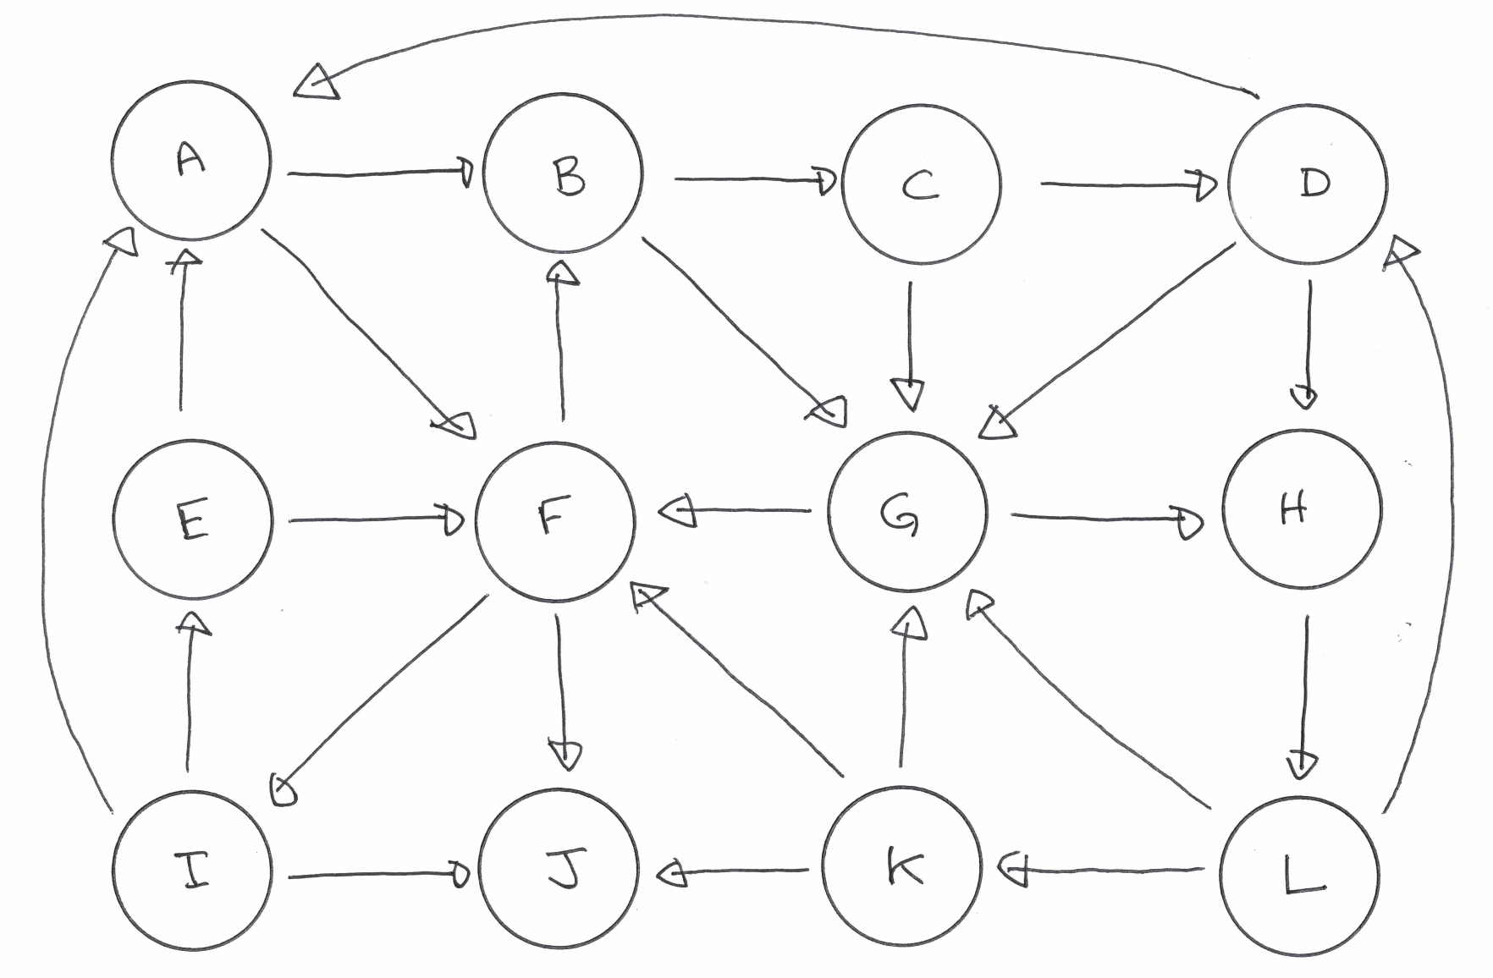
What does the network look like?
Some Terminology:
Nodes (A, B, C, … , L) = Web pages
Directed edges (arrows) = hyperlinks
Ex: edge from A to B acts as a “vote of confidence” from A to B.

Slide 5
Constructing the Raw Google Matrix (G_{raw})
Definition of a transition matrix:
A_{ij} = 1/k
If page i links to page j where k is total outlinks from i
A_{ij} = 0 ; otherwise
We are building a row-normalized adjacency matrix
Each entry represents the transition probability of a user moving from page i to page j

Slide 6
Properties of Raw Matrix G_{raw}
G_{raw} is a row-stochastic matrix
For probability to be conserved in this model, the sum of probabilities of leaving a page must be 1 (100%)
A row that sums to 0 indicates a flaw in the network
Our G_{raw}:
[[0. 1. 0. 0. 0. 0. 0. 0. 0. 0. 0. 0. ]
[0. 0. 1. 0. 0. 0. 0. 0. 0. 0. 0. 0. ]
[0. 0. 0. 0.5 0. 0. 0.5 0. 0. 0. 0. 0. ]
[0.5 0. 0. 0. 0. 0. 0. 0.5 0. 0. 0. 0. ]
[0.5 0. 0. 0. 0. 0.5 0. 0. 0. 0. 0. 0. ]
[0. 0.3333 0. 0. 0. 0. 0. 0. 0. 0.3333 0.3333 0. ]
[0. 0. 0. 0. 0. 0.5 0. 0.5 0. 0. 0. 0. ]
[0. 0. 0. 0. 0. 0. 0. 0. 0. 0. 0. 1. ]
[0. 0. 0. 0. 0.5 0. 0. 0. 0. 0.5 0. 0. ]
[0. 0. 0. 0. 0. 0. 0. 0. 0. 0. 0. 0. ]
[0. 0. 0. 0. 0. 0. 0.5 0. 0. 0.5 0. 0. ]
[0. 0. 0. 0.5 0. 0. 0. 0. 0. 0. 0.5 0. ]]
Row sums:
[1. 1. 1. 1. 1. 1. 1. 1. 1. 0. 1. 1.]
Row for J (index 9) sums to 0.0. Why is this a problem?

Slide 7
02
Eigenvalue Decomposition

Slide 8
The Eigenvalue Problem
Where does it come from?
The problem comes from linear transformations. When a transformation (a matrix) is applied to most vectors, they change both their length and direction. The eigenvalue problem seeks to find the “special “ vectors that keep their original directions and are only stretched or shrunks.
Mathematically…
Represented as Ax = 𝛌x where:
A = transformation matrix, x is eigenvector (specific direction), 𝛌 (scalar that shows how much x stretches or shrinks)
Examples:
PCA: eigenvectors represent principal underlying axes of data, eigenvalues represent the variance along those axes
PageRank: eigenvector represents the stable, underlying importance of web pages

Slide 9
The Equation
The core recursive equation: π^{T} = π^{T}G:
π^{T}: Row vector of web page importance
A page's importance is determined the pages linking to it
This naturally sets up a system of linear equations for the whole network
Transposing both sides: G^{T}π = π:
G^{T}π = π is fundamentally Ax = 𝛌x
G^{T} acts as the linear transformation
π is the eigenvector
𝛌 is the eigenvalue (scalar multiplier) which is 1

Slide 10
Eigenvalue Decomposition of G_{raw}
The eigenvalue equation we are solving: π^{T} = π^{T}G ⇔ G^{T}π = π
Dominant eigenvalue (λ_max): 1.00000000
All eigenvalues (real parts): [1.0000000000000018, 0.625273785016588, 0.3966543094646142, 0.0470618727101512, 0.0470618727101512, -0.05388758350293088, -0.05388758350293088, -0.21774244358192865, -0.21774244358192865, -0.47949354397940336, -0.47949354397940336, -0.6138046977729764]
sum(π) after normalization: 1.00000000 (must be 1.0)
min(π): 0.01312019 (must be ≥ 0)
PageRank vector from raw G (before any fixes):
Page Title π value
A Trees For All 0.104962
B The Weeping Willow 0.052481
C Leaf Fall 0.013120
D Shady Place 0.088674
E The Prickly Pine 0.015835
F Good Wood 0.126678
G Lumber Jack Man 0.159855
H Timber! 0.084301
I Fine Grains 0.047504
J The Warped Board 0.140175
K Evergreen Plants 0.082114
L Sappy Planks 0.084301
λ_max = 1.0000 (expected 1.0, this will be fixed later)

Slide 11
The Danger of Dangling Nodes
Dangling Node: A webpage with 0 outlinks → row of zeros in the matrix
G_{raw}:
[[0. 1. 0. 0. 0. 0. 0. 0. 0. 0. 0. 0. ]
[0. 0. 1. 0. 0. 0. 0. 0. 0. 0. 0. 0. ]
[0. 0. 0. 0.5 0. 0. 0.5 0. 0. 0. 0. 0. ]
[0.5 0. 0. 0. 0. 0. 0. 0.5 0. 0. 0. 0. ]
[0.5 0. 0. 0. 0. 0.5 0. 0. 0. 0. 0. 0. ]
[0. 0.3333 0. 0. 0. 0. 0. 0. 0. 0.3333 0.3333 0. ]
[0. 0. 0. 0. 0. 0.5 0. 0.5 0. 0. 0. 0. ]
[0. 0. 0. 0. 0. 0. 0. 0. 0. 0. 0. 1. ]
[0. 0. 0. 0. 0.5 0. 0. 0. 0. 0.5 0. 0. ]
[0. 0. 0. 0. 0. 0. 0. 0. 0. 0. 0. 0. ]
[0. 0. 0. 0. 0. 0. 0.5 0. 0. 0.5 0. 0. ]
[0. 0. 0. 0.5 0. 0. 0. 0. 0. 0. 0.5 0. ]]
This breaks the math.
→ A row of zeros means the matrix is no longer strictly stochastic (Perron-Frobenius doesn't apply)
→ Probabilities "leak" out of the network at this node
→ We are no longer guaranteed our dominant eigenvalue 𝛌 = 1
→ A random surfer who lands on J is "stuck" with no links to follow

Slide 12
Mathematical Fix for Dangling Nodes
The fix: Replace J's zero row with a uniform distribution 1/n over all pages
When a surfer reaches a dead end, they pick a random page to visit (like typing a random URL)
Mathematically, we artificially add outgoing links to every page in the network with equal probability (1/12 in this case)
Fixed G matrix:
[[0. 1. 0. 0. 0. 0. 0. 0. 0. 0. 0. 0. ]
[0. 0. 1. 0. 0. 0. 0. 0. 0. 0. 0. 0. ]
[0. 0. 0. 0.5 0. 0. 0.5 0. 0. 0. 0. 0. ]
[0.5 0. 0. 0. 0. 0. 0. 0.5 0. 0. 0. 0. ]
[0.5 0. 0. 0. 0. 0.5 0. 0. 0. 0. 0. 0. ]
[0. 0.3333 0. 0. 0. 0. 0. 0. 0. 0.3333 0.3333 0. ]
[0. 0. 0. 0. 0. 0.5 0. 0.5 0. 0. 0. 0. ]
[0. 0. 0. 0. 0. 0. 0. 0. 0. 0. 0. 1. ]
[0. 0. 0. 0. 0.5 0. 0. 0. 0. 0.5 0. 0. ]
[0.0833 0.0833 0.0833 0.0833 0.0833 0.0833 0.0833 0.0833 0.0833 0.0833 0.0833 0.0833]
[0. 0. 0. 0. 0. 0. 0.5 0. 0. 0.5 0. 0. ]
[0. 0. 0. 0.5 0. 0. 0. 0. 0. 0. 0.5 0. ]]
Row sums:
[1. 1. 1. 1. 1. 1. 1. 1. 1. 1. 1. 1.]
Now G is properly stochastic guaranteeing our target eigenvalue exists

Slide 13
Eigenvalue Decomposition of Fixed G
Now that G is stochastic, we expect:
𝛌 = 1 exactly
The corresponding eigenvector has all non-negative entries
The eigenvector is unique (up to scaling) if the Markov chain is irreducible
This is the core mathematical result that makes PageRank work
Results:
Dominant eigenvalue (max of 𝛌): 1.00000000
All eigenvalues:
1.0000000000000009, 0.6252737850165866, 0.3966543094646131, 0.047061872710150776, 0.047061872710150776, -0.053887583502930866, -0.053887583502930866, -0.21774244358192868, -0.21774244358192868, -0.47949354397940364, -0.47949354397940364, -0.6138046977729784)
sum(π) after normalization: 1.00000000
min(π): 0.01312019
✓ 𝛌 max = 1.0
✓ All entries non-negative: True

Slide 14
Normalization
Why do we normalize?
Eigenvectors represent a direction → any scalar multiple is also a valid eigenvector
We force the ||π||₁ norm to equal 1 so the entries of π represent a true probability distribution (the percentage of time a random surfer spends on each page)
How was this done?
The eigenvector is already normalized in the pagerank computation function (we divide by the sum of π)
This ensures that ||π||₁ = ∑_{i}π_{i} = 1 which makes π a valid probability distribution

Slide 15
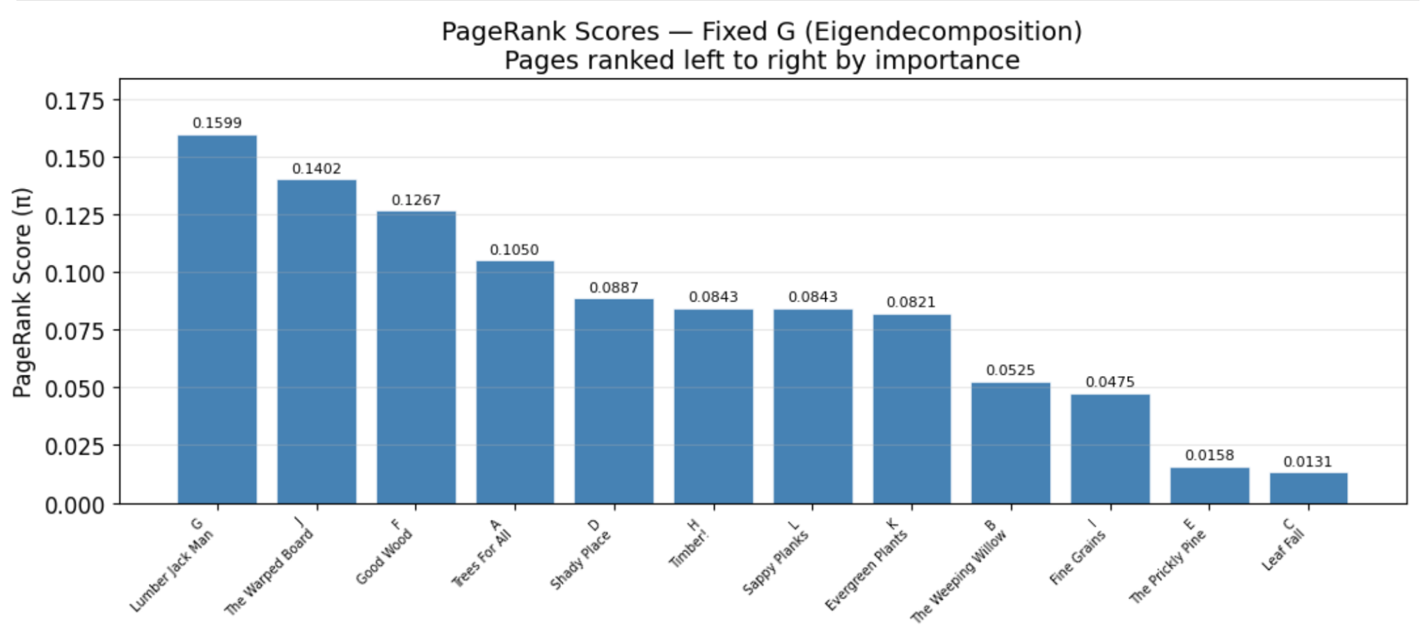
Rank Pages from Eigen Decomp
Now we rank the entries of π in descending order (largest to smallest). The page with the highest π_{i} is the most important page in the network. Here is a visualization of the ranking:

Slide 16
03
Power Method

Slide 17
Challenges with Eigenvalue Decomp
Eigendecomposition takes O(n³) operations
This is fine for a 12-node graph but even then it’s quite computationally expensive
However, for a Google matrix’s n = 3 x 10⁸ pages, this is completely impossible
How do we fix this?
→ The power method!!!

Slide 18
The Power Method
What is it? → An iterative process used to find the “dominant” eigenvector of a matrix (the one associated with the largest eigenvalue of the matrix)
How does it work? → Using a random starting vector π₀^{T}, multiply by matrix A, normalize the result, and repeat the process (p^{(k+1)} = Gp^{(k)})
Why does this process pick up the dominant eigenvector?
Any random starting vector is a combination of the all the matrix’s true eigenvectors
When the matrix is repeatedly multiplied k times, each eigenvector component is multiplied by its respective eigenvalue to the k^{th} power
If 𝛌₁ is the largest eigenvalue, then the term 𝛌₁^{k} grows exponentially faster than all the other 𝛌^{k} terms
As k gets larger, the x₁ component completely overpowers the others basically filtering out all the other components except the dominant eigenvector

Slide 19
The Power Method (cont.)
General Iterative Process:
The update rule: π_{j}^{T} = π_{j-1}^{T} ᐧ G then normalize π_{j} = π_{j} / ||π_{j}||₁
Start at π₀ = 1/n ᐧ 1_{n} (every page is equally likely)
The stopping rule: stop when ||π_{j} - π_{j-1}||₁ ≤ ε
For some tolerance ε
This works because the Power Method is iterative:
→ it only ever computes matrix-vector products which are cheap and can exploit sparsity
→ when we repeatedly multiply a vector by the matrix, the components associated with smaller eigenvalues decay toward zero, isolating the dominant eigenvector

Slide 20
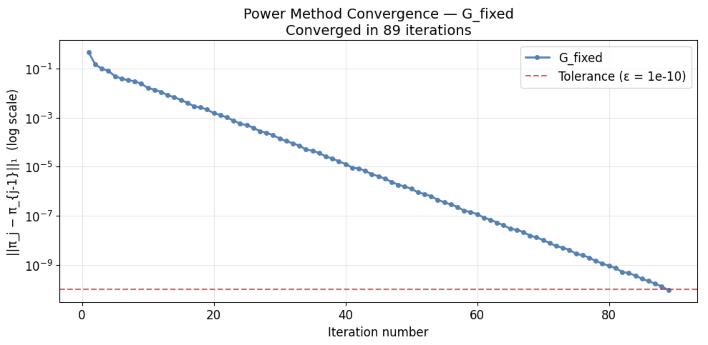
Power Method for fixed G
For this project, we set ε = 1e-10 and the power method converged after 89 iterations.

Slide 21
EigenDecomposition Vs. Power Method
Eigenvalue Decomp
Power Method
Direct mathematical factorization
Breaks a matrix down to reveal all eigenvectors and eigenvalues simultaneously
Provides exact theoretical structure of matrix
Iterative approximation
Does not solve everything at once
Uses brute-force repeated multiplication to isolate single most important vector
Why do they both give the same result?
They are both solving the same problem → Ax = 𝛌x. Eigendecomposition shows that the behavior of a matrix is dictated by its eigenvectors. The Power Method exploits this by repeatedly applying the transformation. The math naturally forces the vector to align with the principal axis defined by the eigendecomposition.

Slide 22
04
Teleportation Matrix

Slide 23
The Reducible Matrix Problem
Even after fixing dangling nodes, the graph may not be strongly connected (there may be subsets of pages that trap the random surfer permanently)
→ This is called a reducible Markov chain, and it produces non-unique or zero-valued PageRank entries for isolated pages.
→ If a graph isn't strongly connected, the matrix is reducible. The random surfer gets trapped, and the PageRank pools entirely into the trap nodes, rendering the rest of the vector zero.
How do we fix this?

Slide 24
The Teleportation Matrix G̃
Brin and Page introduced a "damping factor" where ⍺ = 0.85
G̃ = ⍺G + (1 - ⍺)E where E = (1/n)1_{n}1_{n}^{T}
Probability ⍺ = 0.85, the surfer follows a link normally (modeled by G)
Probability 1 - ⍺ = 0.15, the surfer teleports to any random page (modeled by E)
G̃ has all positive entries (since every entry of E = 1/n which is > 0)
→ makes it irreducible
By Perron-Frobenius, an irreducible stochastic matrix has a unique, fully positive stationary distribution
→ the PageRank vector is now guaranteed to exist and be unique
Building G̃:
E matrix: all entries 1/n = 1/12
⍺ = 0.85
G = fixed G

Slide 25
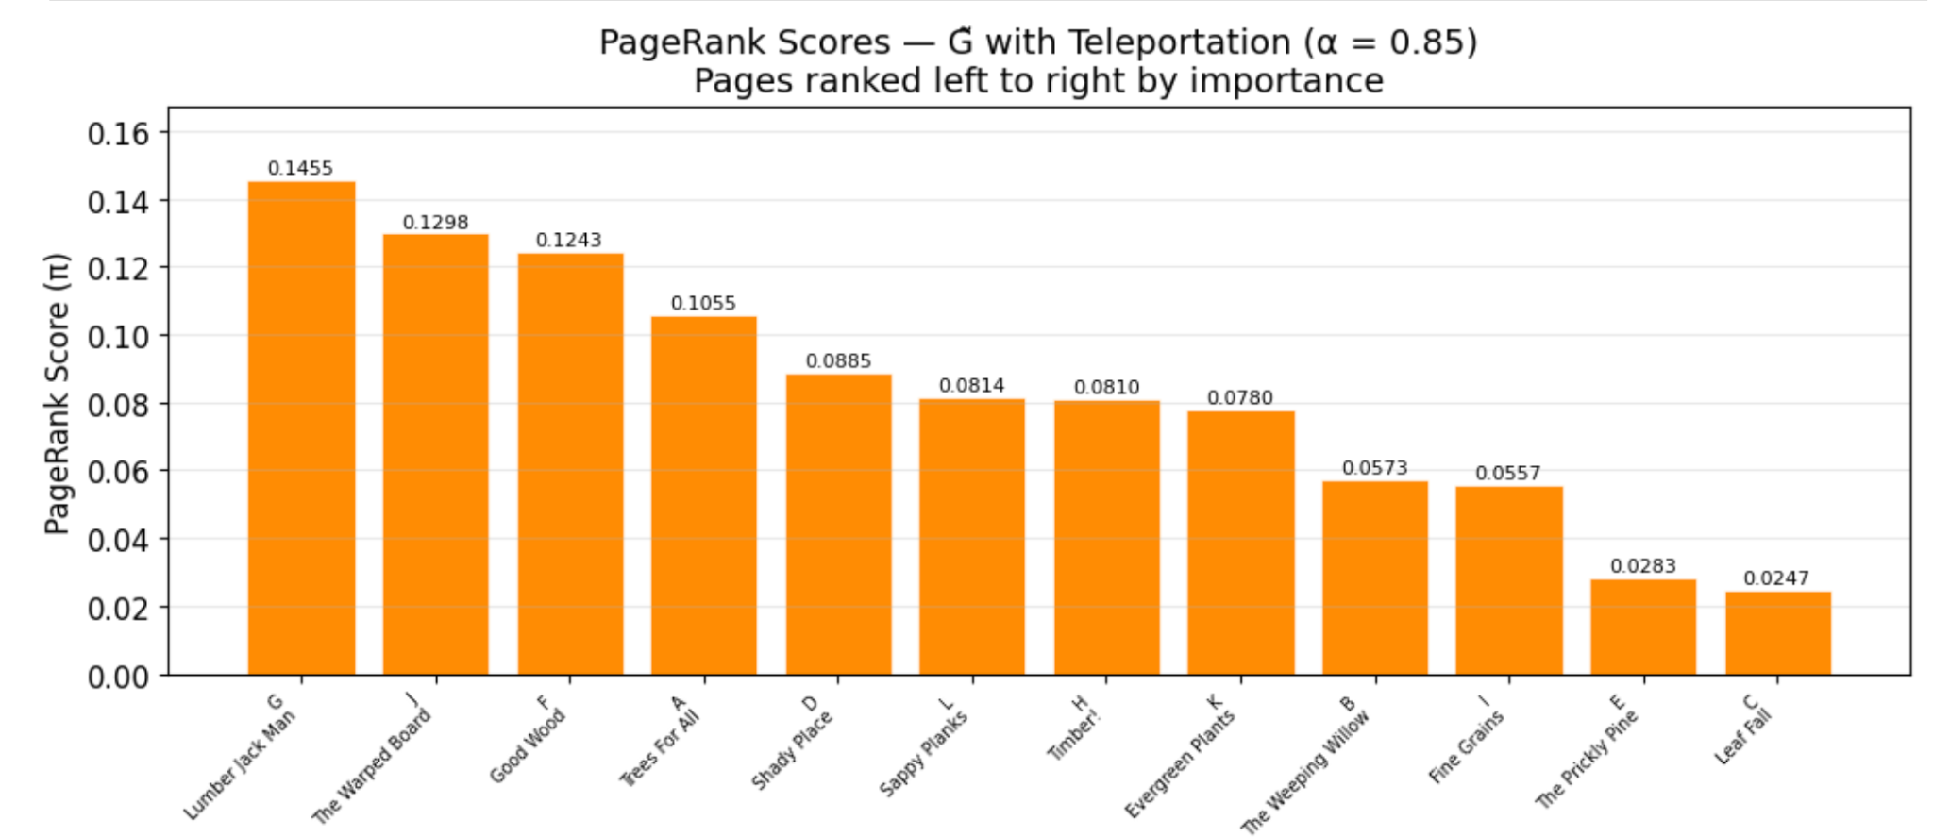
Eigendecomposition, Power Method, and PageRank for G̃
Solve G̃^{T}π = π and get max 𝛌 = 1 and solve using Power Method with G̃ to get max difference of π for power and eigen to be 5.98e-12
Next we compute the PageRank using G̃

Slide 26
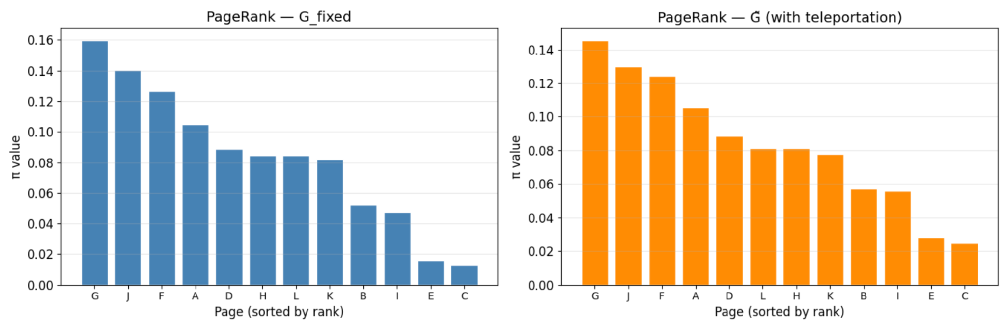
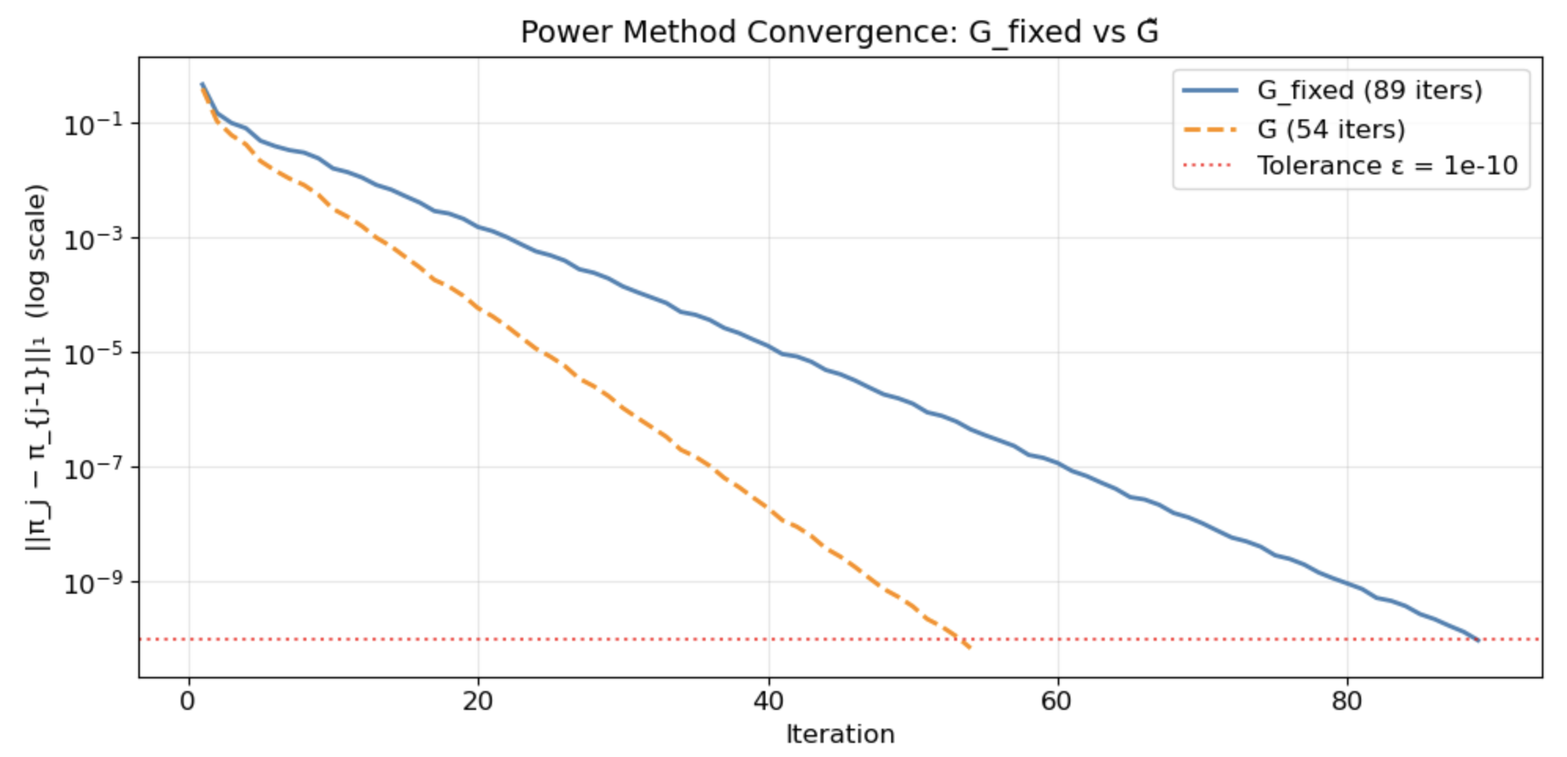
Comparing G̃ and G
Adding teleportation slightly redistributes importance
→ heavily-linked pages lose a little weight because 15% of visits are now uniform random while isolated pages gain a bit
→ This redistribution mitigates the effect of overly dense local clusters
If the top pages remain the same, it confirms the link structure is the dominant factor in determining importance
Results: Nodes L and H switch ranks from 6 and 7 in fixed G to 7 and 6 in G̃ but top pages remain the same

Slide 27
05
Term-Document Matrix

Slide 28
Term-Document Matrix T
What is a term-document matrix? → T is a 17 × 12 binary matrix (17 keywords × 12 pages)
→ T_{kp} = 1 if keyword k appears on page p;
= 0 otherwise
For a query vector q, we compute d = T^{T}q where d is a 12-element vector
→ d_{p} counts how many keywords appear on page p
T[keyword_index][page_index] = 1 if keyword on page, else 0
# Pages: A B C D E F G H I J K L
# Indices: 0 1 2 3 4 5 6 7 8 9 10 11
T =
A B C D E F G H I J K L
Ash [[1 0 1 0 0 1 1 1 0 0 0 0] (A, C, F, G, H)
Aspen [0 0 0 1 0 1 0 1 0 1 0 1] (D, F, H, J, L)
Butternut [1 1 0 1 0 0 1 0 0 0 0 1] (A, B, D, G, L)
Cherry [1 0 0 1 1 0 0 1 0 0 1 0] (A, D, E, H, K)
Elm [1 0 1 0 0 0 0 0 1 0 1 1] (A, C, I, K, L)
Fir [0 1 0 1 0 1 0 0 1 0 1 0] (B, D, F, I, K)
Ginkgo [1 0 1 0 0 1 1 0 0 0 1 1] (A, C, F, G, K, L)
Hickory [0 1 1 0 1 0 0 1 0 0 1 0] (B, C, E, H, K)
Katsura [1 0 1 0 0 0 0 0 1 0 0 1] (A, C, I, L)
Magnolia [1 1 0 0 0 1 0 0 1 1 0 0] (A, B, F, I, J)
Oak [0 0 1 0 1 0 1 0 0 1 0 1] (C, E, G, J, L)
Pine [0 1 0 0 1 0 0 0 1 0 0 1] (B, E, I, L)
Redwood [0 1 1 0 1 1 1 1 0 1 1 0] (B, C, E, F, G, H, J, K)
Sassafras [0 1 0 1 0 1 0 0 1 1 1 1] (B, D, F, I, J, K, L)
Spruce [0 0 0 1 0 1 1 0 1 0 0 1] (D, F, G, I, L)
Teak [1 0 0 1 0 0 0 0 0 0 1 1] (A, D, K, L)
Willow [0 1 0 0 1 0 0 1 0 1 0 0]] (B, E, H, J)

Slide 29
Term-Document Results
Keywords per page:
A (Trees For All): Ash, Butternut, Cherry, Elm, Ginkgo, Katsura, Magnolia, Teak
B (The Weeping Willow): Butternut, Fir, Hickory, Magnolia, Pine, Redwood, Sassafras, Willow
C (Leaf Fall): Ash, Elm, Ginkgo, Hickory, Katsura, Oak, Redwood
D (Shady Place): Aspen, Butternut, Cherry, Fir, Sassafras, Spruce, Teak
E (The Prickly Pine): Cherry, Hickory, Oak, Pine, Redwood, Willow
F (Good Wood): Ash, Aspen, Fir, Ginkgo, Magnolia, Redwood, Sassafras, Spruce
G (Lumber Jack Man): Ash, Butternut, Ginkgo, Oak, Redwood, Spruce
H (Timber!): Ash, Aspen, Cherry, Hickory, Redwood, Willow
I (Fine Grains): Elm, Fir, Katsura, Magnolia, Pine, Sassafras, Spruce
J (The Warped Board): Aspen, Magnolia, Oak, Redwood, Sassafras, Willow
K (Evergreen Plants): Cherry, Elm, Fir, Ginkgo, Hickory, Redwood, Sassafras, Teak
L (Sappy Planks): Aspen, Butternut, Elm, Ginkgo, Katsura, Oak, Pine, Sassafras, Spruce, Teak

Slide 30
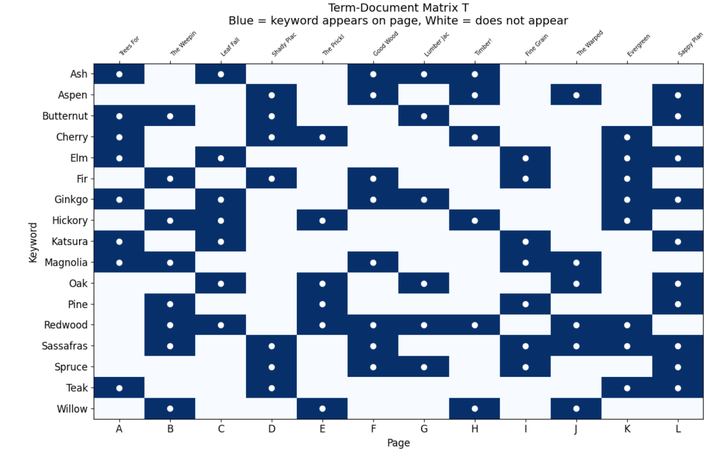
Term-Document Matrix Heatmap

Slide 31
06
The Search Queries

Slide 32
Formulating Query Vector
The process for every query:
Build query vector q → length 17, one entry per keyword
Compute d = T^{T}q → 12 element responsiveness vector
Apply Boolean logic to determine responsive set
Sort responsive pages by G̃
There are four query types:
SINGLE → Page contains the keyword (d[p] > 0)
AND → Page contains all query terms (d[p] == number of terms) OR → Page contains at least one term (d[p] ≥ 1) OR NOT → Page has term A and not term B (T[A][p] == 1 and T[B][p] == 0)
[q acts as a filter, activating only the rows in T that correspond to the search terms]

Slide 33
Identifying Responsive Pages
The projection equation → d^{T} = q^{T}T (or d = T^{T}q by taking transpose of both sides)
The resulting vector d gives us 1 if responsive, 0 if not. The final sorting algorithm takes the set of pages where d_{i} > 0 (responsive) and sort them in descending order based strictly on their corresponding π_{i} values from G̃. Relevance filters the pool and PageRank sorts it.
Query 1: “Elm”:
Query vector q has a 1 only at the index of 'Elm'.
d = T^{T}q → d[p] = 1 if 'Elm' is on page p, else 0.
Responsive set: pages where d[p] > 0
d = T^{T}q (responsiveness scores):
Page A: d = 1 ← responsive
Page C: d = 1 ← responsive
Page I: d = 1 ← responsive
Page K: d = 1 ← responsive
Page L: d = 1 ← responsive
QUERY 1: SINGLE: Elm
Result Page Title PageRank
#1 A Trees For All 0.105515
#2 L Sappy Planks 0.081375
#3 K Evergreen Plants 0.078004
#4 I Fine Grains 0.055719
#5 C Leaf Fall 0.024686

Slide 34
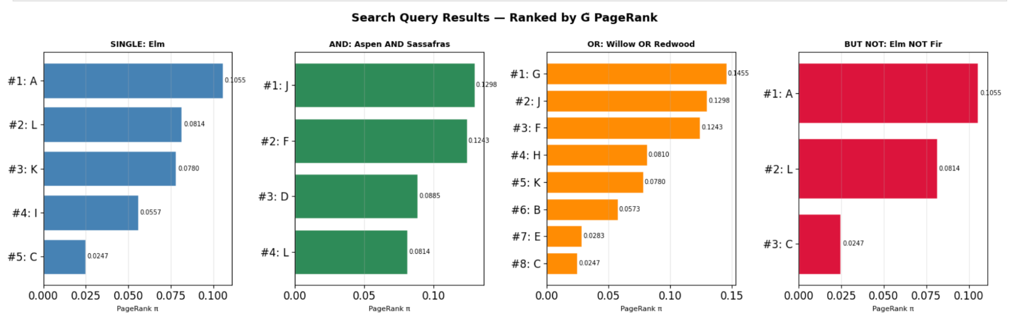
All Queries
Following the process from the last slide, 3 more queries were completed with the following results as shown below.

Slide 35
Thank You!

